Slide 1

Image Data Analytics using Python
Event: FDP on “Text, Image and Video processing using Deep Learning Techniques – Hands-on”
Organization: Mepco Schlenk Engineering College, Sivakasi
Date: Sept 16, 2021
Vivek Raja P S
Data Scientist @ NexStem

Slide 2
Welcome Note
Event: FDP on “Text, Image and Video processing using Deep Learning Techniques – Hands-on”
Session Title: “Image Data Analytics using Python”
Data & Time: Sept 16 , F.N
Organization/ Institution: Mepco Schlenk Engineering College, Sivakasi
Humbled and grateful to my college
Mr. S. Arivazhagan, Principal
Dr.J. Raja Sekar , Professor & Head/CSE
Organizers of the FDP program,
Faculties
Lab Technicians and Support staff

Slide 3

About me..
From Madurai, Tamil Nadu
Graduated B.E (CSE) from Mepco Schlenk Engineering College, 2020.
Data Scientist @ Nexstem, US (https://nexstem.ai)
AWS Community Builder – Machine Learning expert
Organizer @ Azure Developer Communities in Tamil Nadu (3000+ members)
Co-Organizer at AWS User Group India, TensorFlow User Group, Google Developer Group, Pythonista, Tamil FOSS Community
16x Multi—Cloud Certified
Microsoft Certified Data Scientist, AI Engineer, Data Engineer, Developer Associate , Oracle Cloud Solutions Architect, Alibaba Cloud Expert
20 times International & National Hackathon winner
Published 5+ Research papers, + 1 patent (In evaluation) (AI & IoT)
Active Speaker, Mentor, Blogger (Dev, Medium) , Open-source Contributor (Github @Vivek0712)

Slide 4
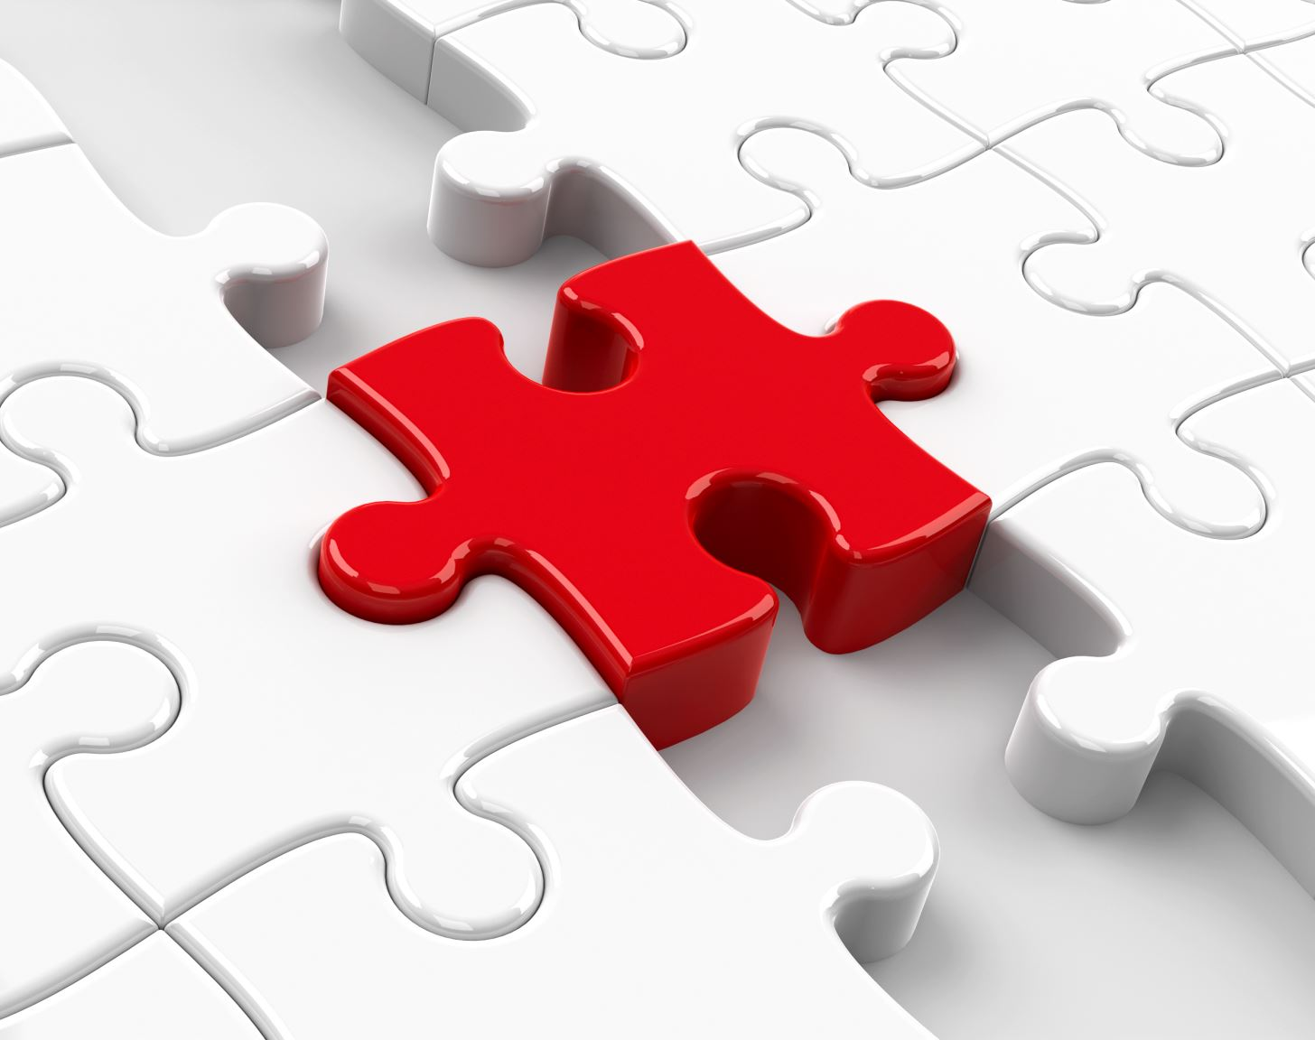
Agenda

Slide 5
Overview of today’s session
Image Processing & Use-cases
Challenges in Image Data Processing
Image Data Processing & Analytics ML Workflow
Hands-on Session
Conclusion

Slide 6
Image Data Analytics
Image Processing or Image Data Analytics is a field of knowledge that falls in Computer Vision. The premises of machine learning were first laid down by computer vision theory, applying a whole set of techniques to process and analyse imagery data to extract valuable information that computers and machines may use for a wide range of applications

Slide 7
Image Data Analytics - Purpose
The intended purpose of Vision is to reconstruct the complex, colorful, and vivid three-dimensional world from the most simple and elementary building blocks leveraging on reliable models that would help to interpret images in an estimable way.

Slide 8
Operations in Image Processing
Pre-processing or namely image processing is a prior step in computer vision, where the goal is to convert an image into a form suitable for further analysis. Examples of operations such as exposure correction, color balancing, image noise reduction, or increasing image sharpness are highly important and very care demanding to achieve acceptable results in most computer vision applications like computational photography or even face recognition.

Slide 9
Image Processing in real world
Medical imaging
In medicine, scientists study the inner structures and tissues of organisms in order to help identify anomalies faster. Image processing used in medical imaging can help produce high-quality, clear images for scientific and medicinal research, ultimately helping doctors diagnose diseases.

Slide 10
Image Processing in real world
Security
A car dealership company, or a shop may install security cameras to monitor the area and record thieves if they appear. But sometimes, images generated by security cameras need to be processed, either by doubling the size or increasing brightness and contrast to make details visible enough to capture important details in it.

Slide 11
Image Processing in real world
General image sharpening and restoration
This is probably the most widely used application of Image Processing. Enhancing and manipulating images using tools like Photoshop, or using filters on Snapchat or Instagram to make our photos more cool.
If you need to automate and process a massive amount of images, it would be a painfully tedious experience to do this manually. This is where machine learning algorithms can boost the speed of image processing, without losing the end quality we need.

Slide 12
Image Processing in real world
Military and defense
An interesting application of Image Processing in Defense is Steganography. Experts can hide a message or an image inside another image, and send the information back and forth without any 3rd party detecting the message.

Slide 13
Challenges in Image Processing
1. Intra-Class Variation
2. Scale Variation
3. View-Point Variation
4. Occlusion
5. Illumination
6. Background Clutter

Slide 14
Challenges (Detail)
Intra-Class Variation
Intra-Class Variation is the variation between the images of same class.
Scale Variation
This problem is very common in image classification. Scale variation is actually having image of same object with multiple size.

Slide 15
Challenges (Detail)
View-Point Variation
We have viewpoint variation, where an object can be oriented/rotated in multiple dimensions with respect to how the object is photographed and captured in image.
4. Occlusion
There are a lot of objects which we want to classify in image can not be view completely. There large part is hidden behind other objects.

Slide 16
Challenges (Detail)
Illumination
Our image classification should also be able to handle changes in Illumination
Background Clutter
It means that there are a lot of objects in the image and for observer it is very tough to find the particular object. These images are very “noisy”.
But we are only interested in one particular object in the image; however, due to all the “noise”, it’s not easy to pick out particular object.
For human it is very difficult task, so imagine how hard it is for a computer with no semantic understanding of the image.

Slide 17
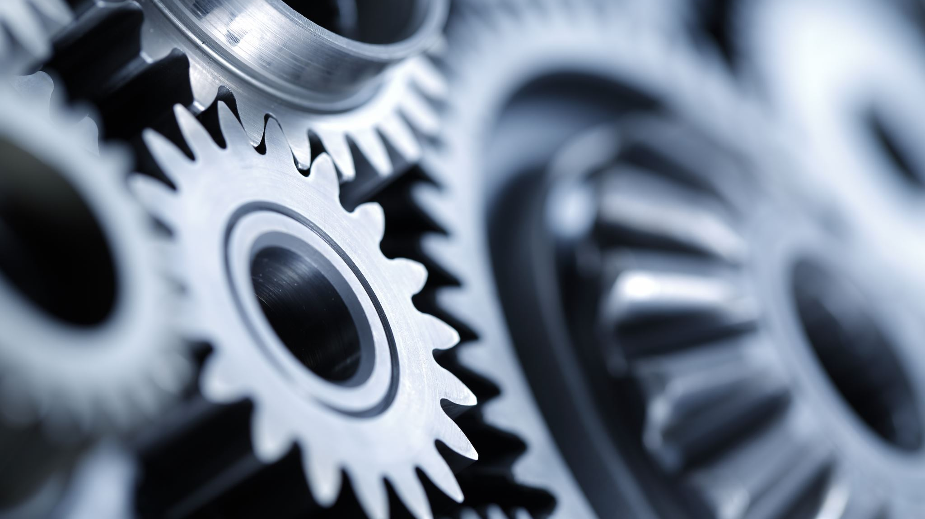
Image Processing & Data Analytics Workflow

Slide 18
Workflow
Identify Data Sources
Create & Organize Datasets
Load Datasets
Pre-process Images
Data Augmentation
Training ML Models
Fine-tuning the models

Slide 19
Identify Data Sources
Kaggle Datasets
UCI Repositories
Stanford & Research Institutes Datasets
Pre-compiled Datasets like CIFAR10
TfDatasets
Self compiled Datasets

Slide 20
Create Datasets
Once the datasets have been identified, copy and load them in the Machine Learning Workspace
Organize datasets by class names (for classification problems)
Use Dataset URLs for batchwise loading and downloading

Slide 21
Hands-on first!
Before deep-diving into Image Pre-processing and Training, lets build a simple Image Classification ML Model to understand the overview of workflow

Slide 22
Basic Image Classification
Basic classification: Classify images of clothing
Google Colab Notebook:
https://github.com/Vivek0712/ML-ImageProcessing/blob/main/FDPclassification.ipynb

Slide 23
Summary of the previous usecase
Dataset Source – TF Datasets
Create Dataset - Using TF Datasets
Loading Dataset – Using tf.keras.dataset.load
Preprocessing Image - Scale these values to a range of 0 to 1 before feeding them to the neural network model. To do so, divide the values by 255

Slide 24
Summary of previous Usecase
Building ML model – tf.keras.Sequential Class
The first layer in this network, tf.keras.layers.Flatten, transforms the format of the images from a two-dimensional array (of 28 by 28 pixels) to a one-dimensional array (of 28 * 28 = 784 pixels). Think of this layer as unstacking rows of pixels in the image and lining them up. This layer has no parameters to learn; it only reformats the data.
After the pixels are flattened, the network consists of a sequence of two tf.keras.layers.Dense layers. These are densely connected, or fully connected, neural layers. The first Dense layer has 128 nodes (or neurons). The second (and last) layer returns a logits array with length of 10. Each node contains a score that indicates the current image belongs to one of the 10 classes.

Slide 25
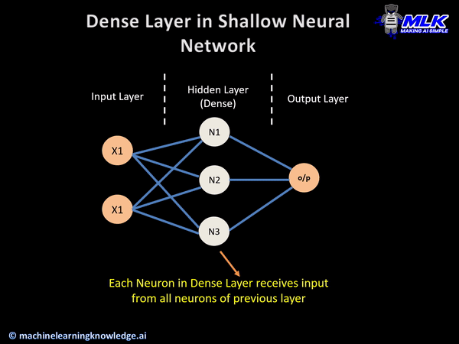
Keras Dense Layer

Slide 26
ReLU Action Function Explained
In a neural network, the activation function is responsible for transforming the summed weighted input from the node into the activation of the node or output for that input.
The rectified linear activation function or ReLU for short is a piecewise linear function that will output the input directly if it is positive, otherwise, it will output zero. It has become the default activation function for many types of neural networks because a model that uses it is easier to train and often achieves better performance.

Slide 27
Summary of Previous Use-case
Compile the model
Before the model is ready for training, it needs a few more settings. These are added during the model's compile step:
Loss function —This measures how accurate the model is during training. You want to minimize this function to "steer" the model in the right direction.
Optimizer —This is how the model is updated based on the data it sees and its loss function.
Metrics —Used to monitor the training and testing steps. The following example uses accuracy, the fraction of the images that are correctly classified.

Slide 28
Optimizer – Adam Algorithm Explained
Pre-requisite: What is Gradient Descent?
Gradient Descent is an iterative optimisation algorithm, used to find the minimum value for a function. The general idea is to initialize the parameters to random values, and then take small steps in the direction of the “slope” at each iteration. Gradient descent is highly used in supervised learning to minimize the error function and find the optimal values for the parameters.

Slide 29
Optimizer – Adam Algorithm Explained
Adaptive Moment Estimation (Adam) Algorithm
Adam optimizer involves a combination of Momentum & Root Mean Square Propagation.
Here, we control the rate of gradient descent in such a way that there is minimum oscillation when it reaches the global minimum while taking big enough steps (step-size) so as to pass the local minima hurdles along the way. Hence, combining the features of the above methods to reach the global minimum efficiently.

Slide 30
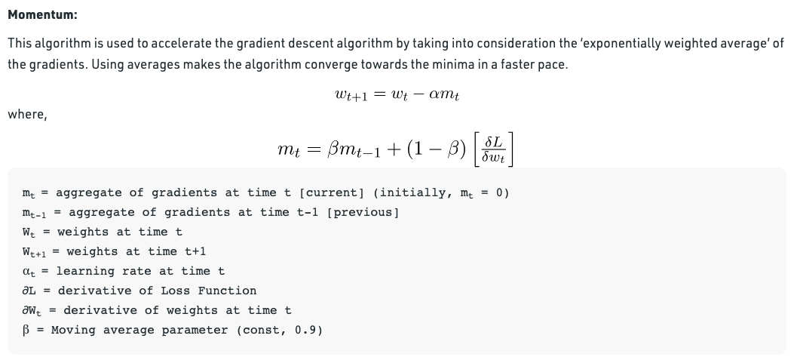
Optimizer – Adam Algorithm Explained

Slide 31
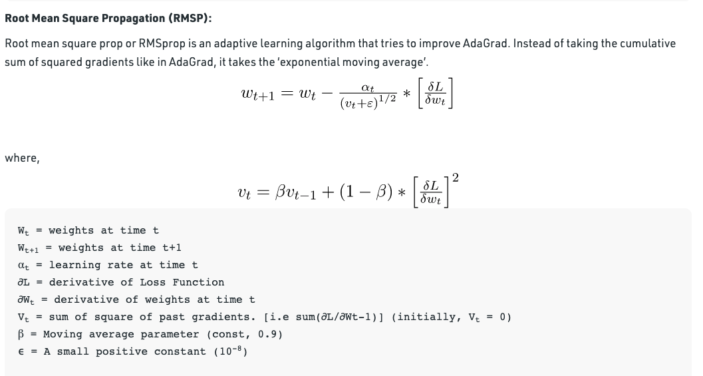
Optimizer – Adam Algorithm Explained

Slide 32
Summary of Previous Use-case
Train the model
Training the neural network model requires the following steps:
Feed the training data to the model. In this example, the training data is in the train_images and train_labels arrays.
The model learns to associate images and labels.
You ask the model to make predictions about a test set—in this example, the test_images array.
Verify that the predictions match the labels from the test_labels array.

Slide 33
Loading Dataset
Efficiently loading a dataset off disk.
Classify images of flowers. This tutorial uses a dataset of about 3,700 photos of flowers. The dataset contains 5 sub-directories, one per class.

Slide 34
Creating Dataset
Let's load these images off disk using the helpful image_dataset_from_directory utility. This will take you from a directory of images on disk to a tf.data.Dataset in just a couple lines of code. If you like, you can also write your own data loading code from scratch by visiting the load images tutorial.
It's good practice to use a validation split when developing your model. Let's use 80% of the images for training, and 20% for validation.

Slide 35
Loading & Creating the Dataset
Google Colab Notebook:
https://github.com/Vivek0712/ML-ImageProcessing/blob/main/FDP_ImageClassification.ipynb
Following the earlier procedure – Standardize the dataset, build, train the model.

Slide 36
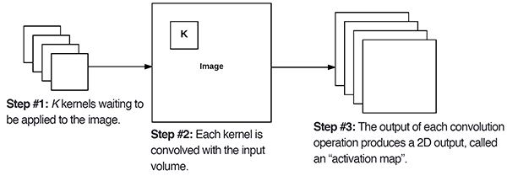
Analysing our CNN Model – Conv2D layer
The first required Conv2D parameter is the number of filters
that the convolutional layer will learn.Layers early in the network architecture (i.e., closer to the actual input image) learn fewer convolutional filters while layers deeper in the network (i.e., closer to the output predictions) will learn more filters.

Slide 37
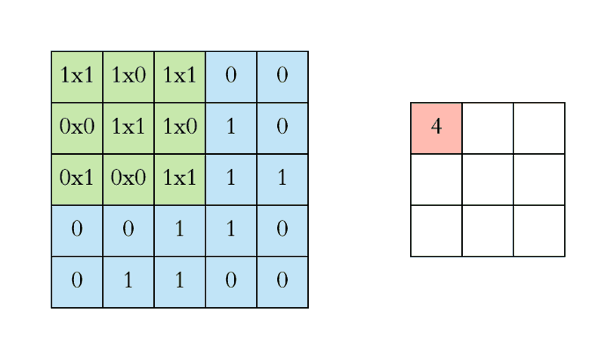

Slide 38
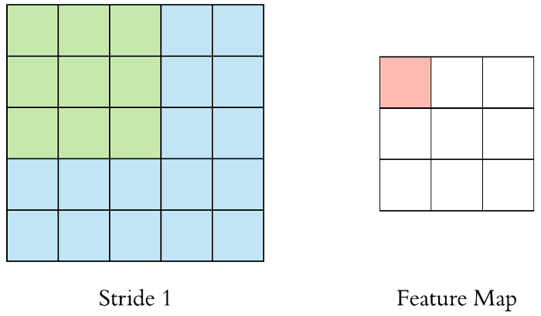
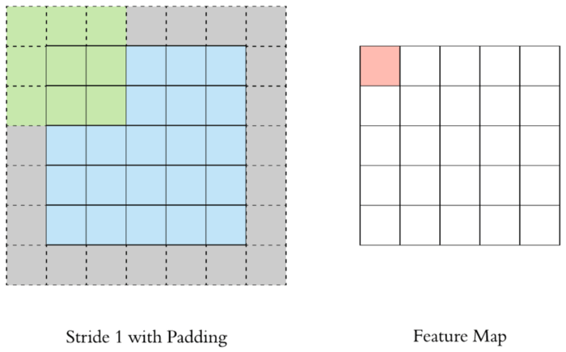
Analysing our CNN Model – Filters, Padding, Stride
Stride specifies how much we move the convolution filter at each step. By default the value is 1, as you can see in the figure below.
Padding is commonly used in CNN to preserve the size of the feature maps, otherwise they would shrink at each layer, which is not desirable.

Slide 39
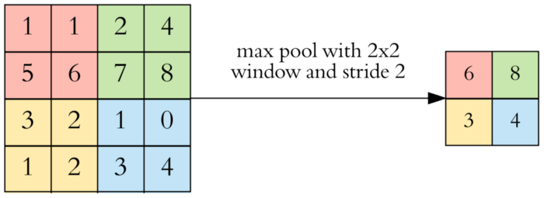
Analysing our CNN model - Max Pooling Layer
After a convolution operation we usually perform pooling to reduce the dimensionality. This enables us to reduce the number of parameters, which both shortens the training time and combats overfitting. Pooling layers downsample each feature map independently, reducing the height and width, keeping the depth intact.

Slide 40
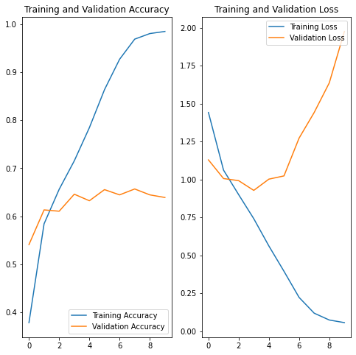
Results of CNN model Training (NO Pre-processing & fine-tuning)
In the plots above, the training accuracy is increasing linearly over time, whereas validation accuracy stalls around 60% in the training process. Also, the difference in accuracy between training and validation accuracy is noticeable—a sign of overfitting.
When there are a small number of training examples, the model sometimes learns from noises or unwanted details from training examples—to an extent that it negatively impacts the performance of the model on new examples. This phenomenon is known as overfitting. It means that the model will have a difficult time generalizing on a new dataset.
There are multiple ways to fight overfitting in the training process. In this tutorial, you'll use data augmentation and add Dropout to your model.

Slide 41
Processing Images
Morphological Transformations
Data Augmentation

Slide 42
Morphological Transformations
The term morphological transformation refers to any modification involving the shape and form of the images.
These are very often used in image analysis tasks. Although they are used with all types of images, they are especially powerful for images that are not natural (come from a source other than a picture of the real world).

Slide 43
Morphological Transformations
Thresholding
One of the simpler operations where we take all the pixels whose intensities are above a certain threshold and convert them to ones; the pixels having value less than the threshold are converted to zero. This results in a binary image.
Erosion shrinks bright regions and enlarges dark regions.
Dilation on the other hand is exact opposite side — it shrinks dark regions and enlarges the bright regions.

Slide 44
Morphological Transformations
Opening is erosion followed by dilation. This tends to “open” up (dark) gaps between (bright) features.
Closing is dilation followed by erosion. This tends to “close” up (dark) gaps between (bright) features.

Slide 45
Data Augmentation
Data augmentation takes the approach of generating additional training data from your existing examples by augmenting them using random transformations that yield believable-looking images. This helps expose the model to more aspects of the data and generalize better.
Data augmentation like flipping, rotation, cropping, translation, illumination, scaling, adding noise, etc., makes the model learns all variations. This significantly boosts the accuracy of the model.

Slide 46
Processing Images
Morphological Transformations
Data Augmentation
Google Colab Notebook:
https://github.com/Vivek0712/ML-ImageProcessing/blob/main/FDP_Processing.ipynb

Slide 47
Improving model
Preventing Overfitting by
Data Augmentation
Dropout

Slide 48
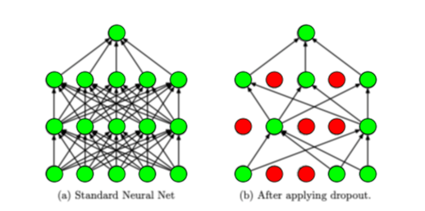
Dropout Regularization
Dropout regularization works by removing a random selection of a fixed number of the units in a network layer for a single gradient step. The more units dropped out, the stronger the regularization. This is analogous to training the network to emulate an exponentially large ensemble of smaller networks.

Slide 49
Other Common Regularization Methods
When it comes to combating overfitting, dropout is definitely not the only option. Common regularization techniques include:
Early stopping: stop training automatically when a specific performance measure (eg. Validation loss, accuracy) stops improving
Weight decay: incentivize the network to use smaller weights by adding a penalty to the loss function (this ensures that the norms of the weights are relatively evenly distributed amongst all the weights in the networks, which prevents just a few weights from heavily influencing network output)
Noise: allow some random fluctuations in the data through augmentation (which makes the network robust to a larger distribution of inputs and hence improves generalization)
Model combination: average the outputs of separately trained neural networks (requires a lot of computational power, data, and time)

Slide 50
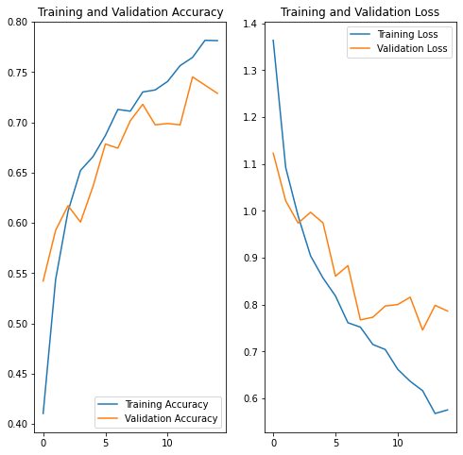
Result of CNN Model ( Data Augmentation + Dropout Layer)

Slide 51
Transfer Learning
A pre-trained model is a saved network that was previously trained on a large dataset, typically on a large-scale image-classification task. You either use the pretrained model as is or use transfer learning to customize this model to a given task.
The intuition behind transfer learning for image classification is that if a model is trained on a large and general enough dataset, this model will effectively serve as a generic model of the visual world. You can then take advantage of these learned feature maps without having to start from scratch by training a large model on a large dataset.

Slide 52
Transfer Learning + Fine-tuning
Fine tuning
In the feature extraction experiment, you were only training a few layers on top of an MobileNet V2 base model. The weights of the pre-trained network were not updated during training.
One way to increase performance even further is to train (or "fine-tune") the weights of the top layers of the pre-trained model alongside the training of the classifier you added. The training process will force the weights to be tuned from generic feature maps to features associated specifically with the dataset.

Slide 53
Improving Transfer Learning Model
Other ways to improve the model is to add the Dropout layer to avoid overfitting and improve Validation Accuracy

Slide 54
To Summarize today’s session
What is Image Processing and why it is important?
What all the challenges we face while implementing the same?
Understanding how to work in Image Data Analytics Problem
Machine Learning Steps
Finding your Data source
Collecting & Organizing the dataset

Slide 55
To Summarize today’s session
Loading your dataset in memory efficient manner
Standardizing the dataset
Creating a simple CNN model to understand Image Classification
Analysing why simple CNN model wasn’t able to give better result
Understanding different layers in CNN
Optimizer and Loss Function Algorithms
Creating a CNN model without Pre-processing

Slide 56
To Summarize today’s session
Understand why CNN model overfitted on data
Exploring ways to prevent overfitting
Pre-processing Techniques – Morphological and Augmentation
Understanding how Dropout regularization works
Creating and training CNN model
Visualizing and analyzing the results

Slide 57
To Summarize today’s session
Understanding Transfer Learning Approach
Why Transfer Learning is best for quick and decent results?
How to fine-tune Transfer Learning model?
Comparing Results

Slide 58
Future points to ponder
Feature Selection from extracted features
Feature selection methods aim to select a subset of the original high-dimensional features based on some performance criterion. Therefore, they can preserve the semantics of the original features and produce dimensionally reduced results that are more interpretable for domain experts. Another advantage of feature selection is that once the low-dimensional features have been selected, one only needs to collect or calculate the selected features during data acquisition. This can be helpful because sometimes the measurement of all feature is costly or practically impossible.

Slide 59
Feature Selection methods
Filter & Wrapper Methods
Optimization Techniques

Slide 60
Future points to ponder
Image Segmentation
In an image classification task the network assigns a label (or class) to each input image. However, suppose you want to know the shape of that object, which pixel belongs to which object, etc. In this case you will want to assign a class to each pixel of the image. This task is known as segmentation. A segmentation model returns much more detailed information about the image. Image segmentation has many applications in medical imaging, self-driving cars and satellite imaging to name a few.
Code Sample: https://www.tensorflow.org/tutorials/images/segmentation

Slide 61
Face Recognition & Detection
Facial Landmark Detection
Emotion Detection
Getting Started:https://machinelearningmastery.com/how-to-perform-face-detection-with-classical-and-deep-learning-methods-in-python-with-keras/

Slide 62
Why not Cloud?
Pre-trained Computer Vision APIs for Face, Emotion, Object & Scene.
AWS AI Services: https://www.youtube.com/watch?v=hWvPq0OyaEo
Azure Cognitive Services: https://www.youtube.com/watch?v=brl8TdnLiIs

Slide 63
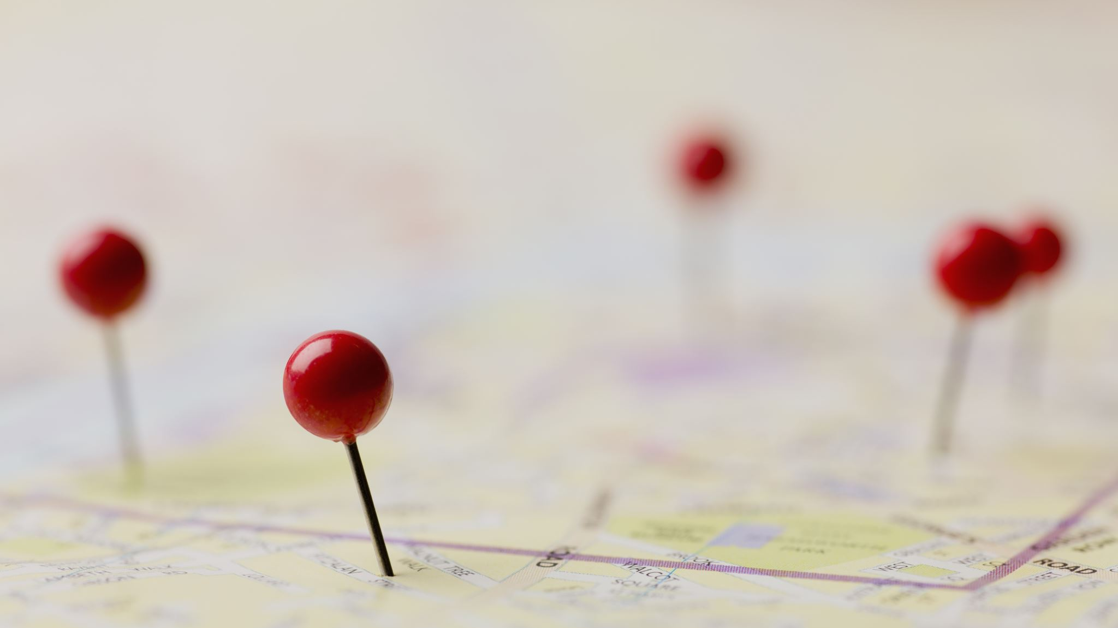
References

Slide 64
References & Resources
Source Code & Presentation Decks:
  https://github.com/Vivek0712/ML-ImageProcessing
  References & Dataset:
  Kaggle
  Tensorflow Documentation & Code Samples

Slide 65

Q&A

Slide 66
Connect with me!
Social Handles:
Email: vivekraja98@gmail.com
Linkedin: https://linkedin.com/in/Vivek0712
Twitter: https://twitter.com/VivekRaja007
Repos:
GitHub: https://github.com/Vivek0712
Blogs:
Medium: https://vivekraja98.medium.com
Dev.to: https://dev.to/vivek0712
Meetups / Developer Communities:
Azure Developer Community: https://azdev.konfhub.com
AWS User Groups: https://www.meetup.com/awsusergroup-chennai/
Google Developers Group Madurai: https://www.gdgmadurai.in
TensorFlow User Groups : https://www.meetup.com/TFUGCbe/
Work Related Enquires:
For BCI enquiry/ purchase / Developer Program: vivek@cortexbci.com / https://nexstem.ai

